Slide 1
WELCOME COLBY SCHOOL DISTRICT
Stakeholder Driven Strategic Planning
December 11, 2013

Slide 2
December 11, 2013 @ 6:00 PM
Middle School LMC
Where are we? Where are we going?
Paul reviews strategic planning process and purpose future meetings. (5)
Data Based decision Making (5)
Data presentation from Clark County (15)
Data presentation from Steve (15)
Review SOAR flip chart prioritization results from
November 21st meeting (10)
Based on additional information presented by Clark County and DA Kolden, any additional SOARs?
Mission, Vision (45)
January meetings- (10)
January 8th
Set last meeting in January

Slide 3
Where are we?
Where are we going?
Data based
decision making
School Facts
Baird Financial
abbycolby Chamber

Slide 4
Data
Clark County
Information

Slide 5
Data Request
Participation Trends
Extra-Curricular

Slide 6
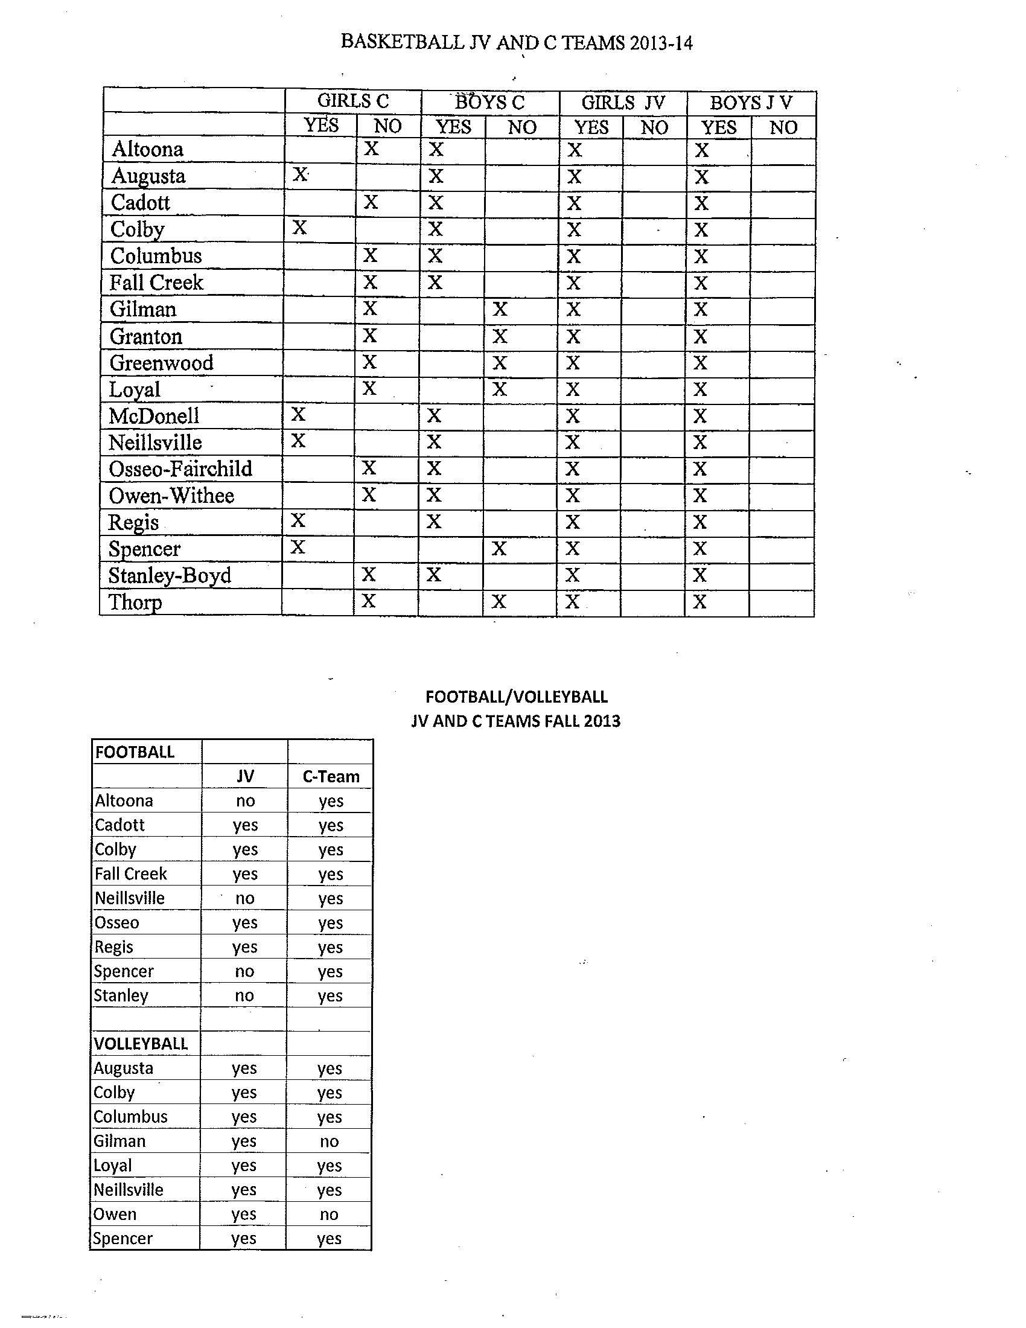

Slide 7
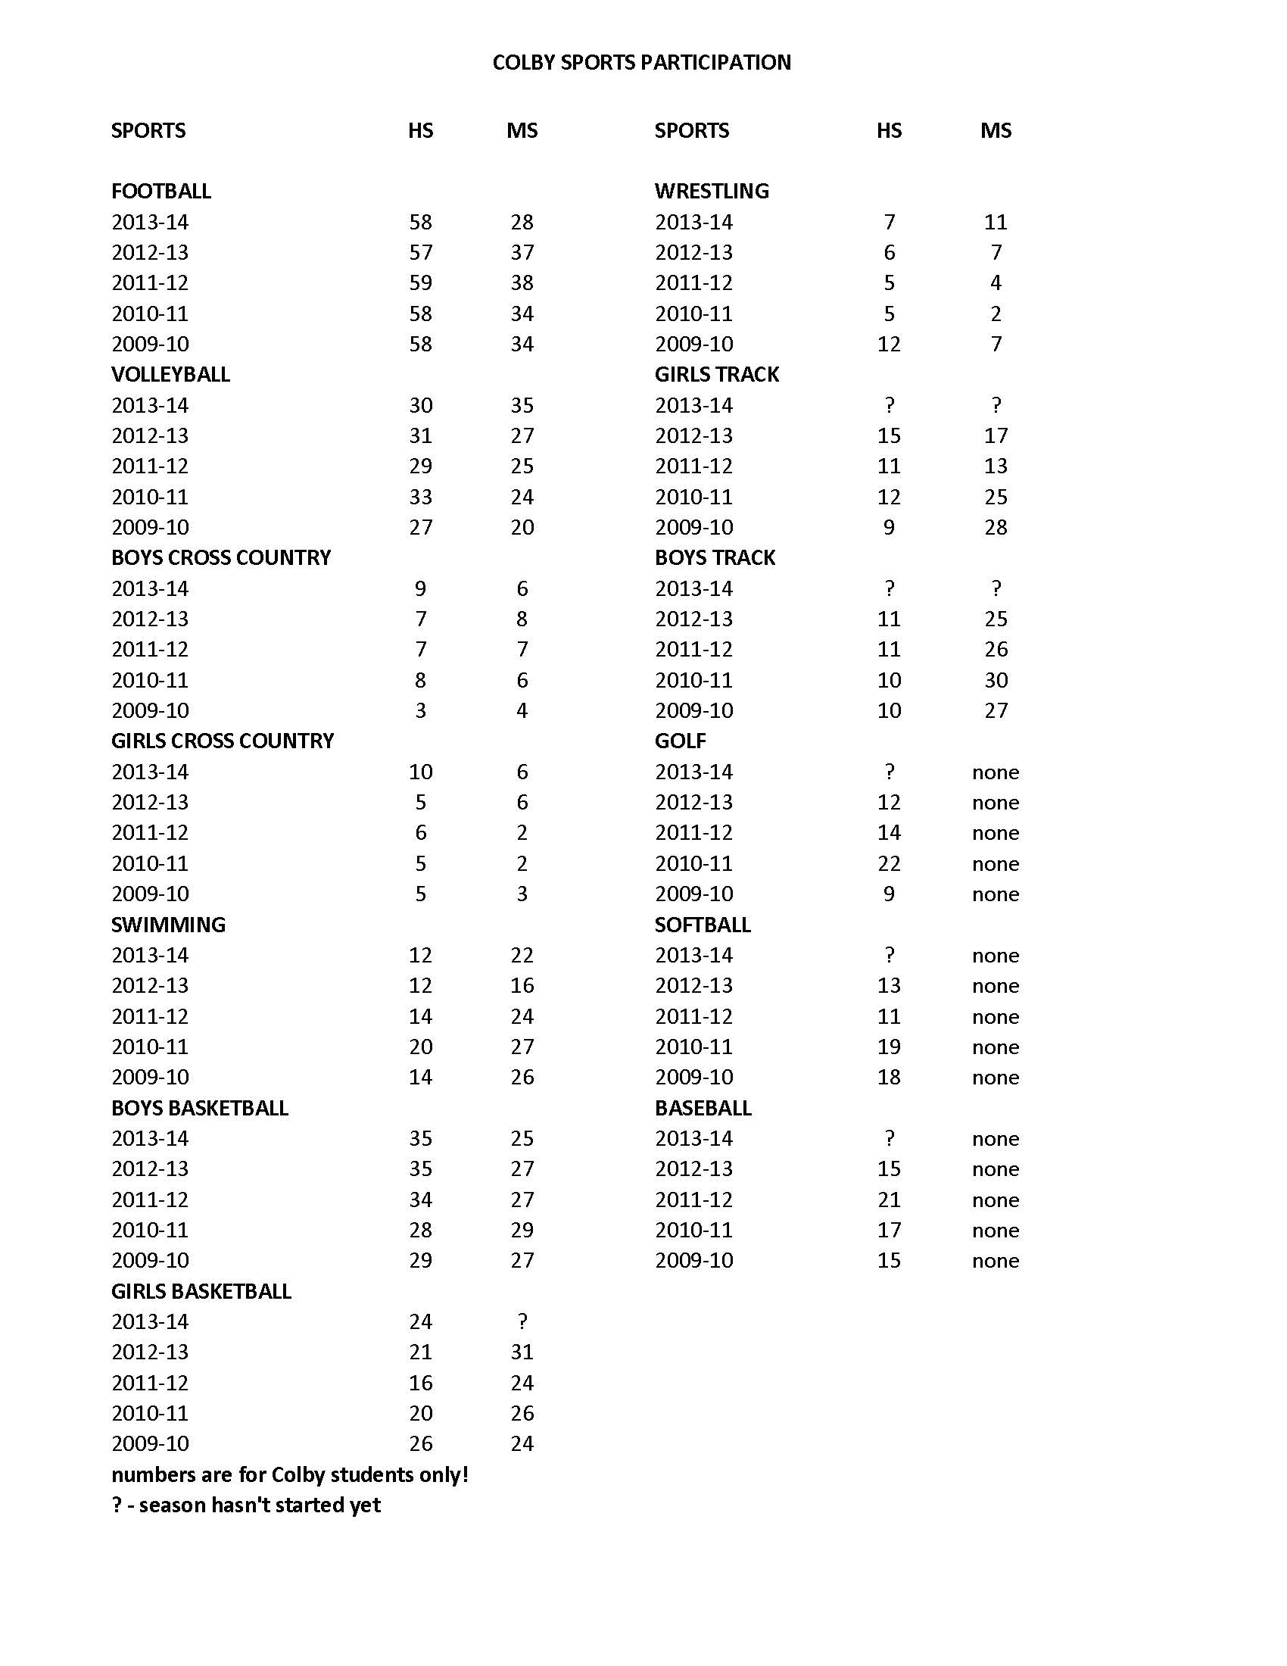

Slide 8
Data Request
Cooperation with other Districts
List of courses “offered”
That did not run due to
low student requests

Slide 9
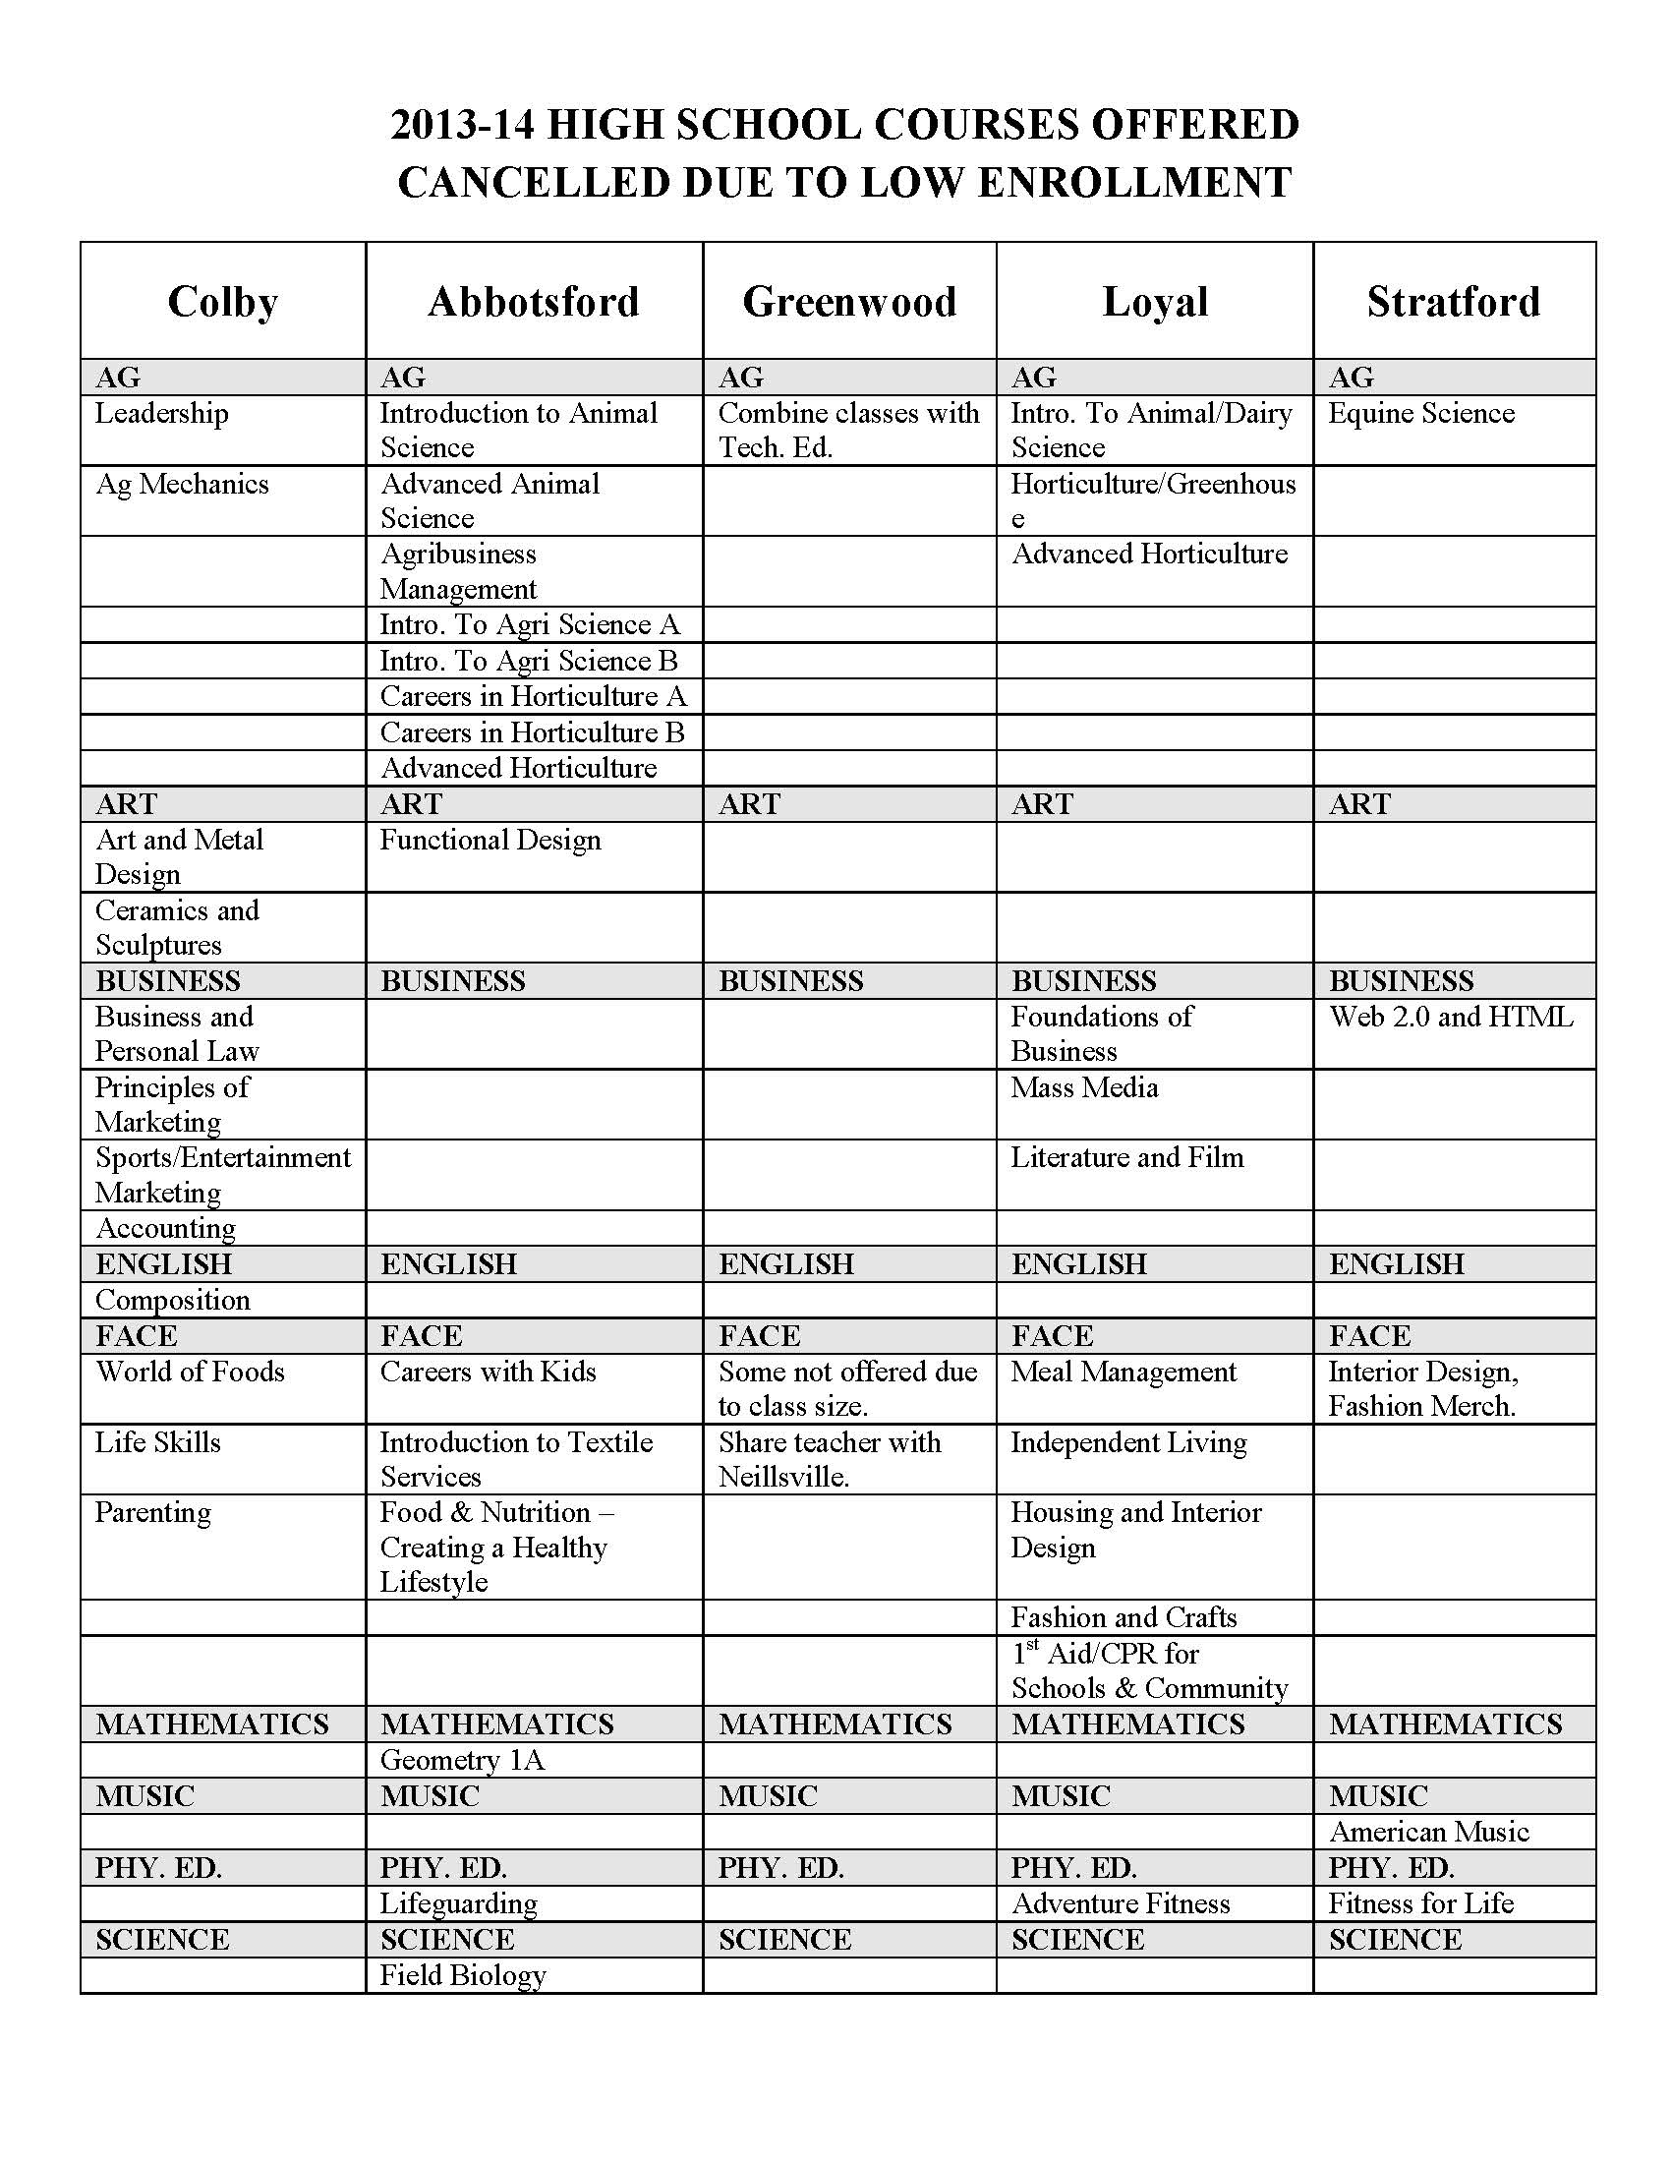

Slide 10
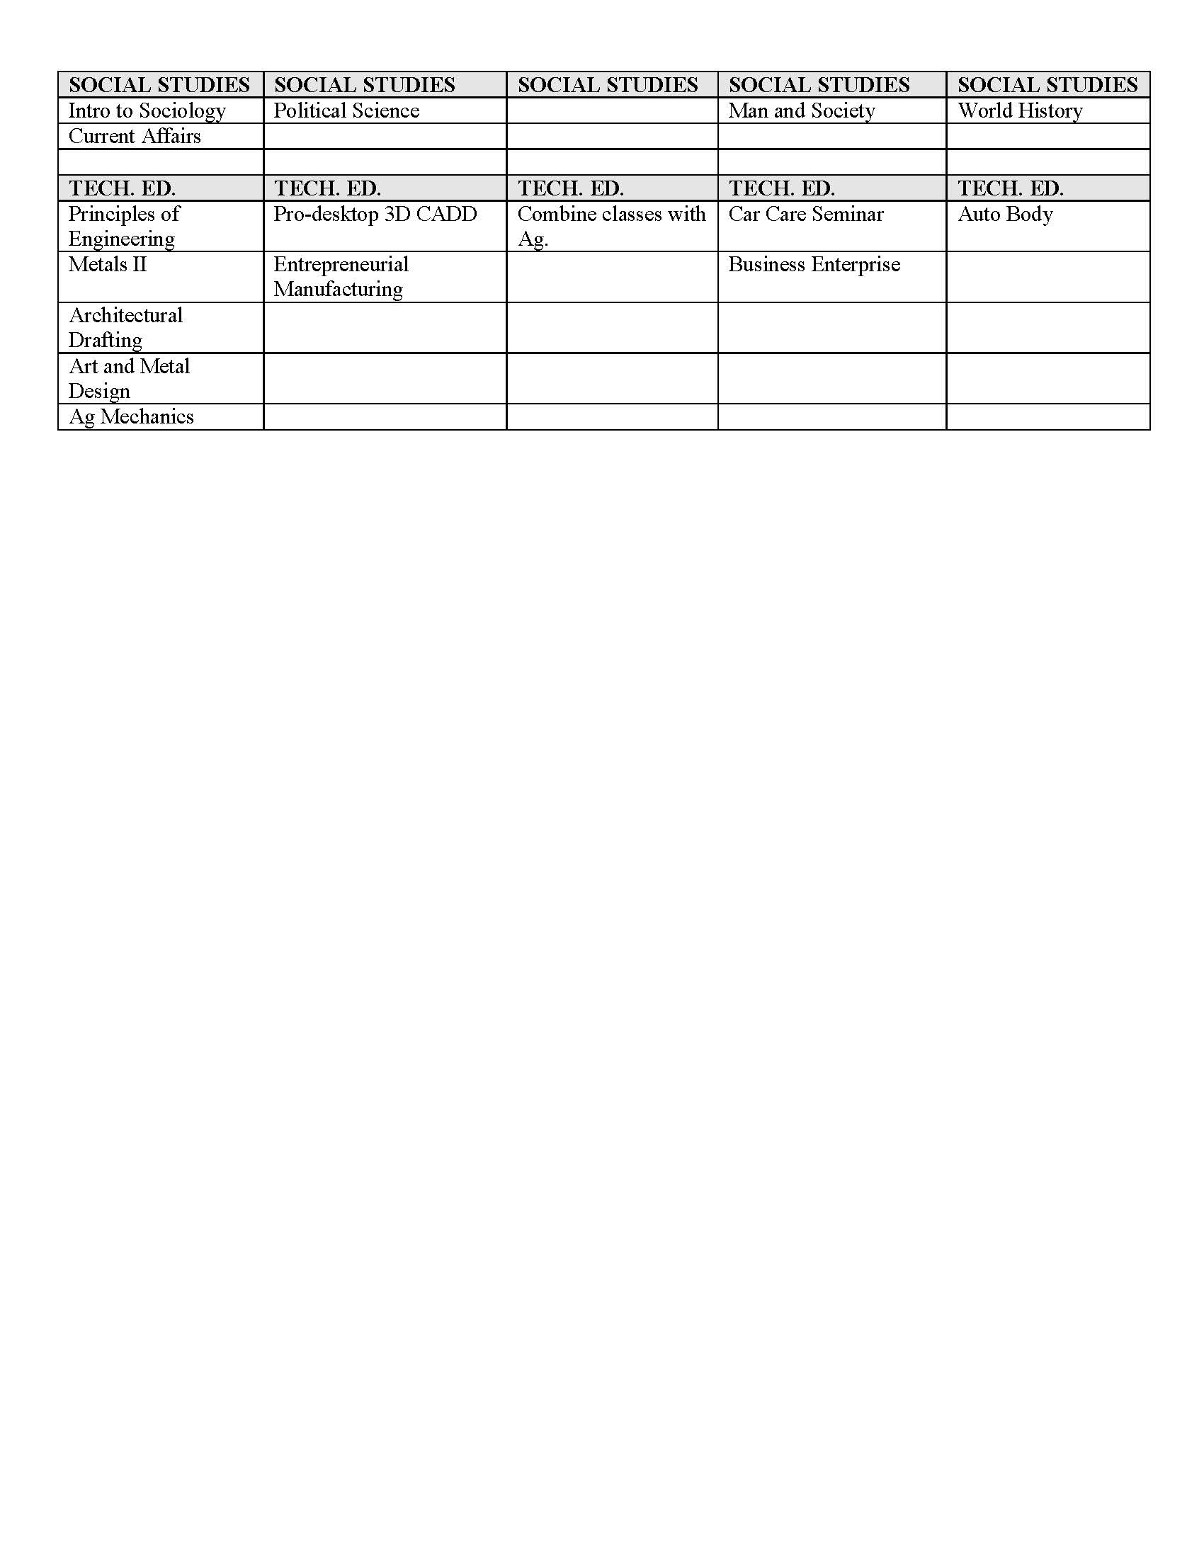

Slide 11
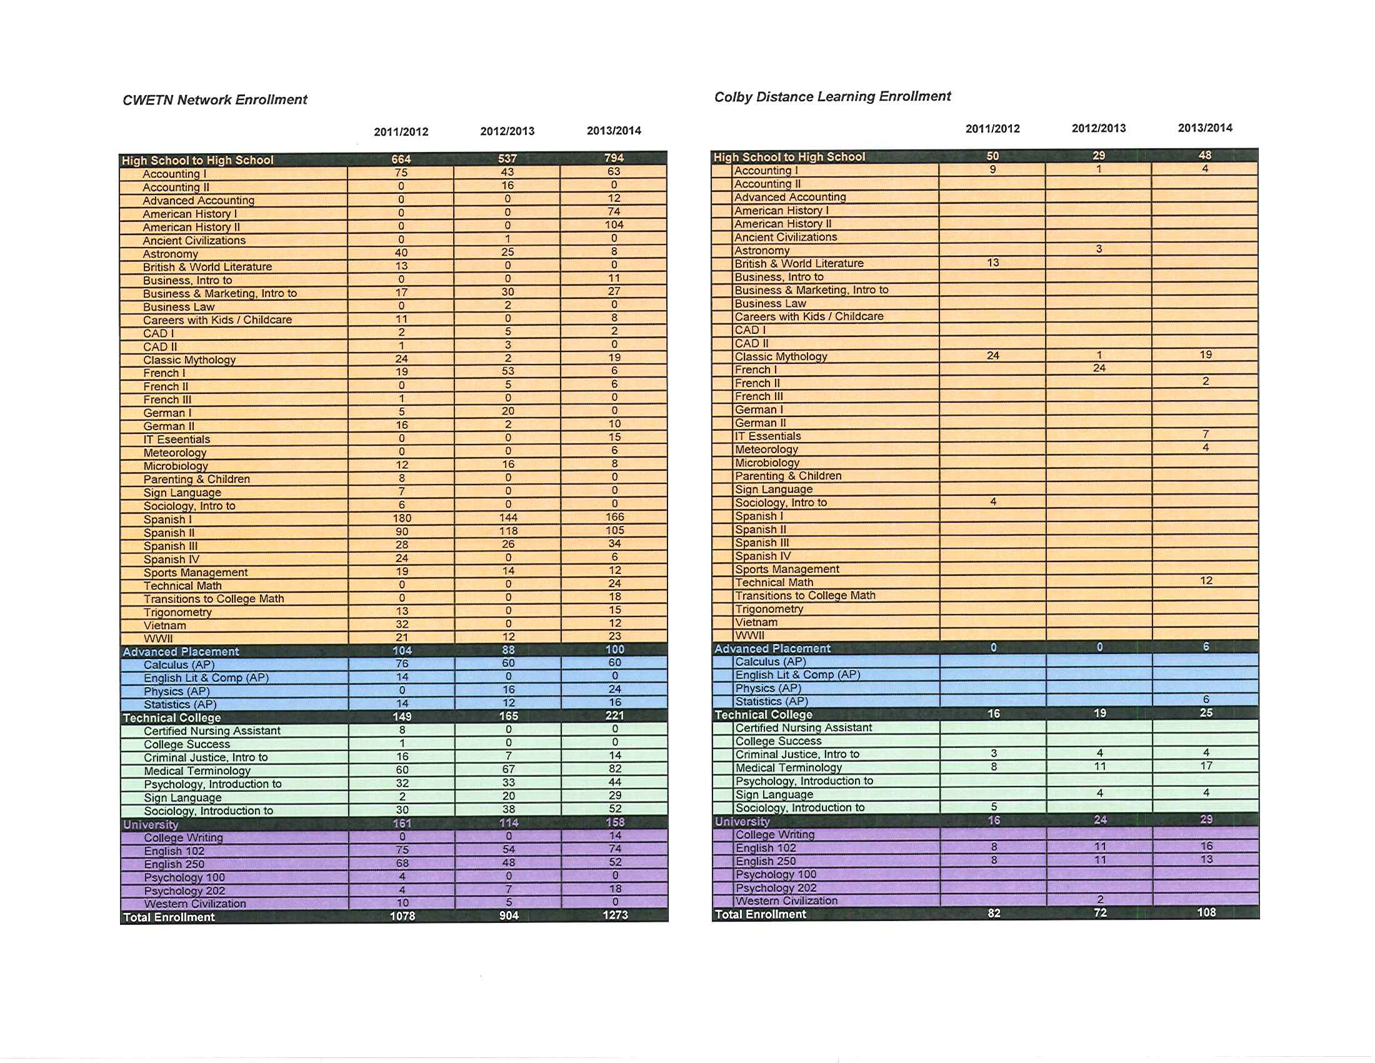

Slide 12
SOAR Results Prioritization Activity

Slide 13
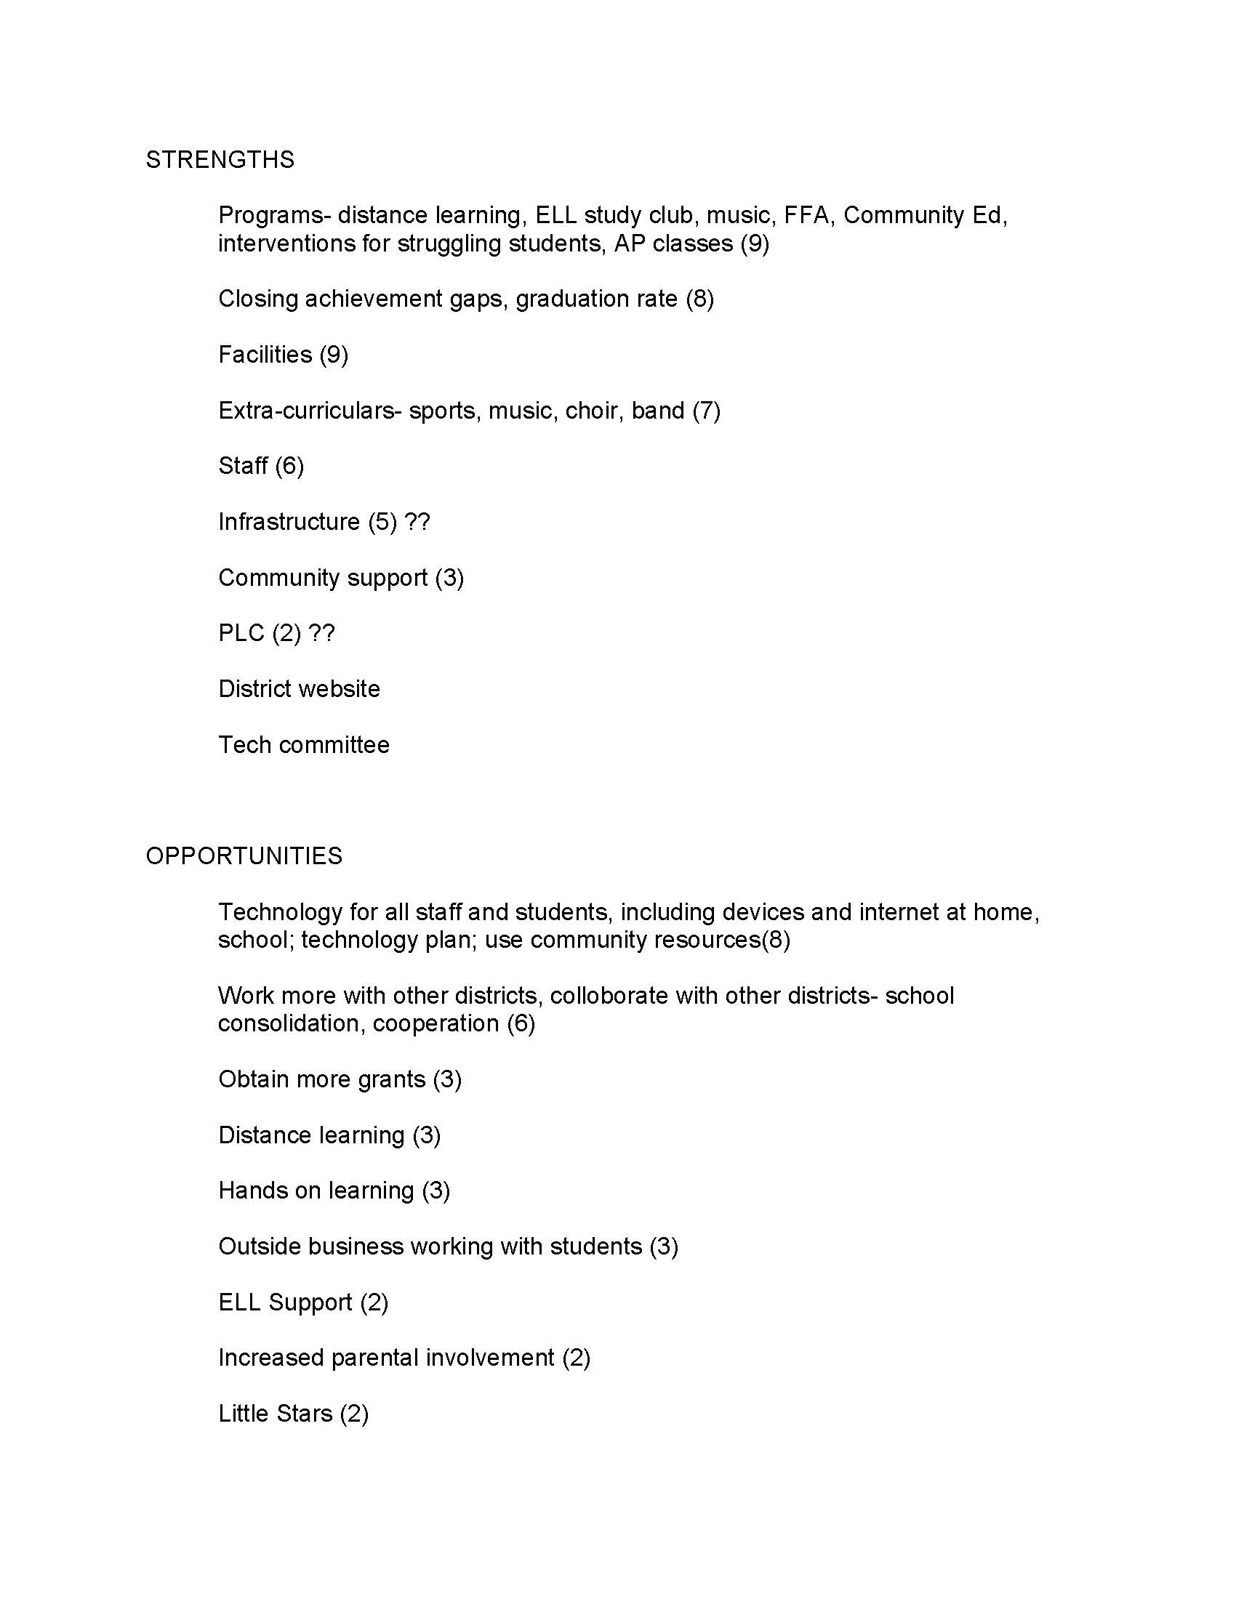

Slide 14
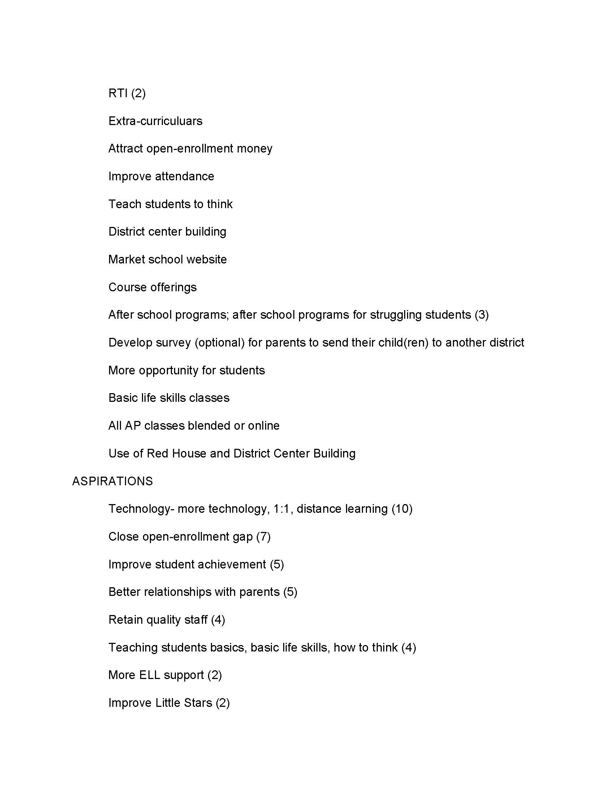

Slide 15
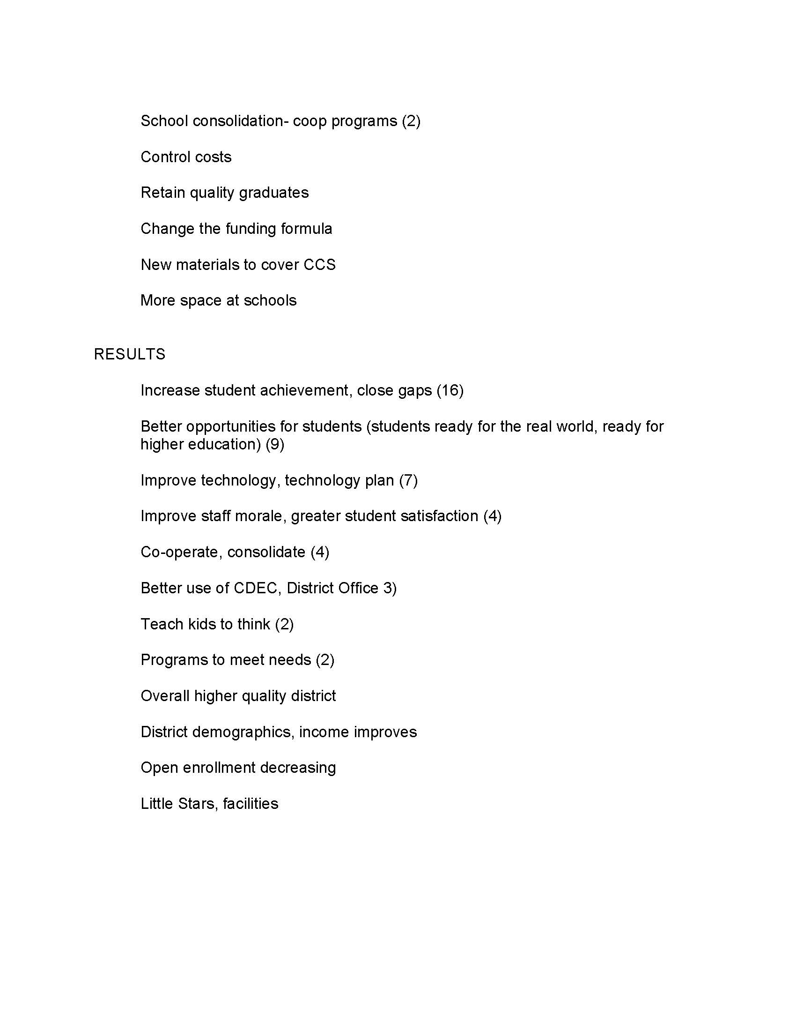

Slide 16
Mission and Vision

Slide 17
Mission Statement
The Mission of the School District of Colby is Learning.

Slide 18
Vision
SCHOOL DISTRICT OF COLBY POLICY#: 110
SECTION: BOARD OF EDUCATION
REVISED: 01/21/02
REVISED: 10/22/12
EDUCATIONAL PHILOSOPHY
The Board of Education of the School District of Colby recognizes the importance of accepting the individual into the system as he/she is, and providing him/her with a stimulating environment and learning experience designed to promote the purposes set forth in the following philosophy.
MISSION STATEMENT
The mission of the School District of Colby is LEARNING for ALL.

Slide 19
Vision
SCHOOL DISTRICT OF COLBY POLICY#: 110
PHILOSOPHY OF SCHOOL DISTRICT OF COLBY
The purposes of education in the Colby Public Schools are four-fold. They are best defined as self-realization,
human relationship, economic efficiency and civic responsibility.
For self-realization, the school must provide the student with opportunities and learning experiences
compatible with his respective abilities. The educational program should be broad and general for all youth,
but still maintain a diversity of quality and balance that lends to individual differences. Effort should be made
to develop the student, not only in the so-called formal instructional fields, but also in the areas of aesthetic
values such as literature, music, and art. In addition, the student should be provided with opportunity to
ascertain his own strengths and weaknesses, capacities and limitations in terms of his own environment and
should be exposed to the joys of achieving goals that he and society find desirable.
continued

Slide 20
Vision
PHILOSOPHY OF SCHOOL DISTRICT OF COLBY (continued)
Social growth and human relationship in the student must be fostered and guided. The student must identify
his position in the home, church, and society in general. It is desirable that he know the satisfaction of joining
in a variety of interests and activities with others and recognize that his own development and welfare is, in
part, the product of the influence of others.
It is the purpose of the school to educate the student as a wise consumer of goods and services. Economic
efficiency as a potential producer should also be stressed. The wise selection of a chosen field of work is to be
encouraged. Emphasis should be placed on securing a desirable balance between the individual's needs and his
wants.
Instruction in civic responsibility is to be offered. The individual must recognize and observe laws as
necessary for personal and group relations. Citizenship and the responsibilities of a citizen to his government
should be incorporated into the curriculum as well as educational experiences that encourage the individual's
desire to become a useful member of society.

Slide 21
Vision
PHILOSOPHY OF SCHOOL DISTRICT OF COLBY (continued)
It is recognized that the function of education is not restricted to the school. Cooperation from the home,
church, and society is necessary for a sound foundation for useful and happy living in a society. The school
should be responsive to the demands of the citizens of the community. The educational program should be
elastic enough to be sensitive to the will of the people.
The school recognizes the needs of youth as defined by the Education Policies Commission of the National
Education Association. These needs are met to the best of the school's ability and are listed as follows:
IMPERATIVE NEEDS OF YOUTH
All youth need to develop salable skills and those understandings and attitudes that make the worker an
intelligent and productive participant in economic life. To this end, most youth need supervised work
experience as well as education in the skills and knowledge of their occupations.

Slide 22
Vision
PHILOSOPHY OF SCHOOL DISTRICT OF COLBY (continued)
All youth need to understand the rights and duties of the citizen of a democratic society, and to be diligent and
competent in the performance of their obligations as members of the community and citizens of the state and
nation.
All youth need to understand the significance of the family for the individual and society and the conditions
conducive to successful family life.
All youth need to understand the methods of science, the influence of science on human life, and the main
scientific facts concerning the nature of the world and of man.
All youth need opportunities to develop their capacities to appreciate beauty in literature, art, music, and
nature.
All youth need to be able to use their leisure time well and to budget it wisely, balancing activities that yield
satisfactions to the individual with those that are socially useful.

Slide 23
Vision
PHILOSOPHY OF SCHOOL DISTRICT OF COLBY (continued)
All youth need to develop respect for other persons, to grow in their insight into ethical values and principles,
and to be able to live and work cooperatively with others.
All youth need to grow in ability to think rationally, to express their thoughts clearly, and to read and listen
with understanding.
LEGAL REFERENCE: Wisconsin Stats. 118.01, 118.13, 118.30(1g), 121.02(1)
REVISED: 01/21/02
REVISED: 10/22/12

